Slide 1
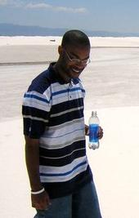
Brian Adams
My Life
Born in San Bernardino, Ca
Lived in Izmir, Turkey 3 years
Graduated High School in
Okinawa, Japan
Traveled around the world by age 18
Transferred from Eastern New
Mexico University
Senior at New Mexico State University

Slide 2
Aspirations in Higher Education
Bachelors degree in Marketing
with sports option
Law School to obtain Juris Doctorate (J.D.)
Degree and Business Administration
(J.D./M.B.A.)

Slide 3
Future Expectations
Practice Public Interest Law
Become a Athletic Director at college sports level
Become leader in community activism
Eventually travel back overseas
Live Life…and Smile as much as possible

Slide 4
Paragon Learning Style
I (S/N)TP
Introvert
Sensate/Intuitive (Very rare, less than 10% of population)
Thinker
Perceiver
Quiet and reserved; Tend to have sharply defined
interests; Good deal of attentiveness and seclusiveness;
Like solving problems with logic and analysis; Observing
and analyzing life with detached curiosity

Slide 5
Fantastic Quotes for Life
Life is just a chance to grow a soul.
Arthur Powell Davies
And in the end, it's not the years in your life that count. It's the life in
your years.
Abraham Lincoln
Life is 10% of what happens to me and 90% of how I react to it.
John Maxwell
Never regret. If it's good, it's wonderful. If it's bad, it's experience. Victoria Holt
Sometimes I could be so analytical, with no audience, so who am I a
critic to?
Brian Adams

